Slide 1
Reparature Doc Generator
By: Austin Ibele

Slide 2
Program Structure
The program is written as one continuous function. The code executes from the top line to the bottom.

Slide 3
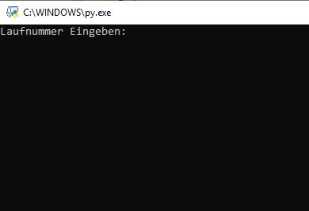
Starting Program
Open the Python file at Alle/ERSTools/Reparature Doc Generator/
Enter Rep Number and hit enter
Data is extracted from '//fileserver/service/Reparatur/R Liste 2013 Überwachung.xls'

Slide 4
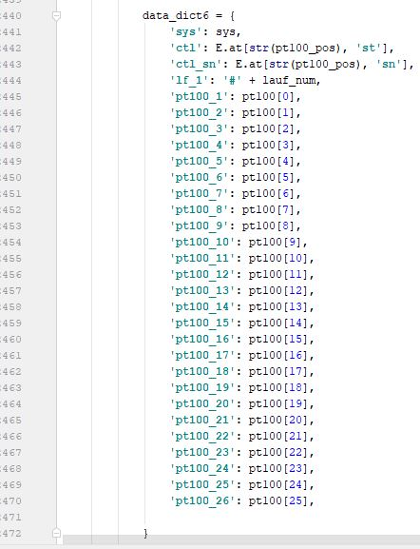
Making changes to documents
Fillable PDFs are created from an Open Office format document
You cannot change the fields in Word. You NEED Open Office
https://smallbusiness.chron.com/create-openoffice-fillable-forms-74857.html
Green text in data dict = names of fields in Open Office
Note: Fields in open office do not have a border in the completed documents.
I suggest using a border while working on the document formatting, and
then removing the border later

